Slide 1
What to do and not to do at Starbucks
By: Jared Dyreson

Slide 2
https://www.youtube.com/watch?v=KNZSXnrbs_k

Slide 3
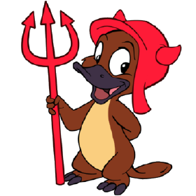
Meet Darwin
Suiting, right?

